Slide 1
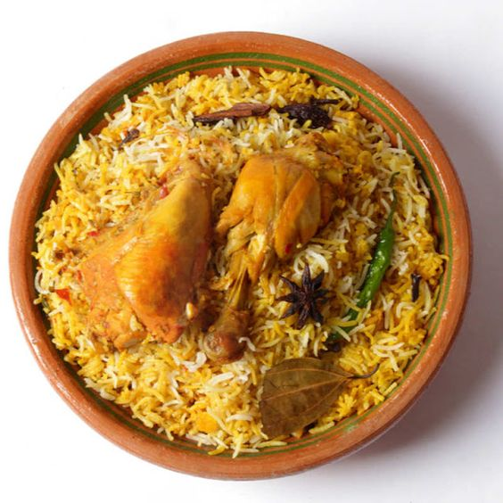
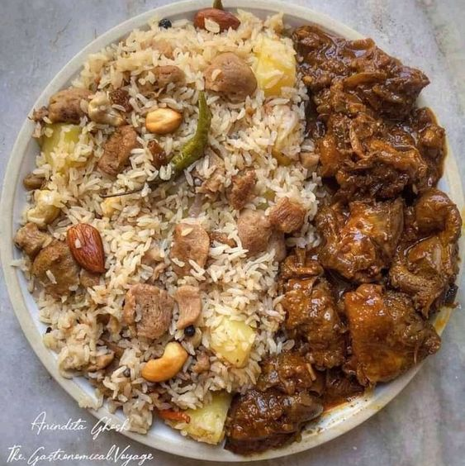
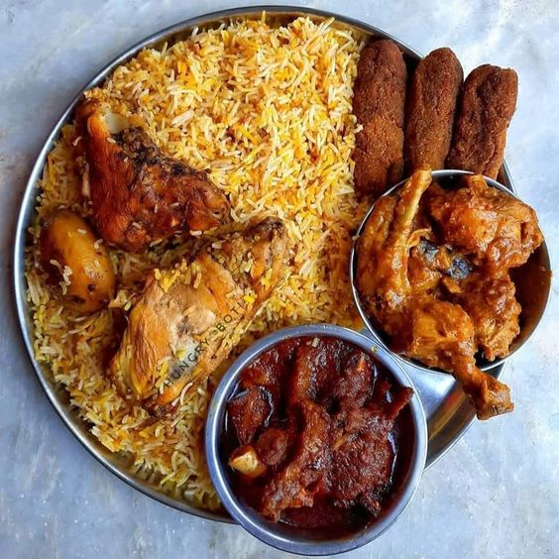
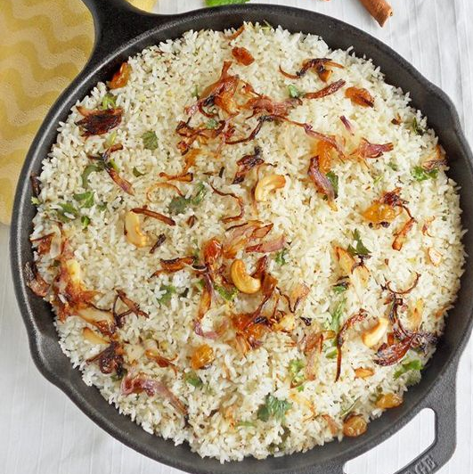
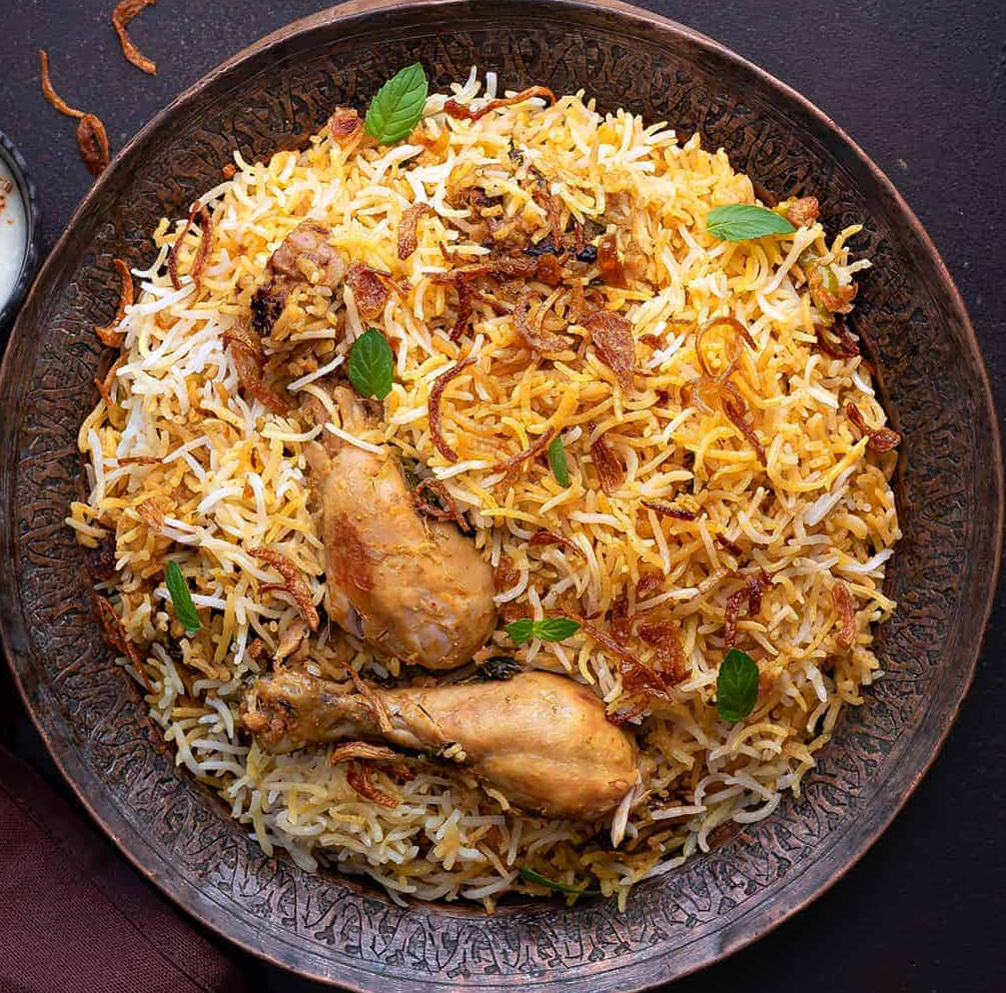
1
2
3
4
5
Profit | 23 | 5 | 17 | 20 | 10
x | 15 |  | 15 | 15
Owner gets | 8 |  | 2 | 5 |  | = 15 Taka

